Slide 1
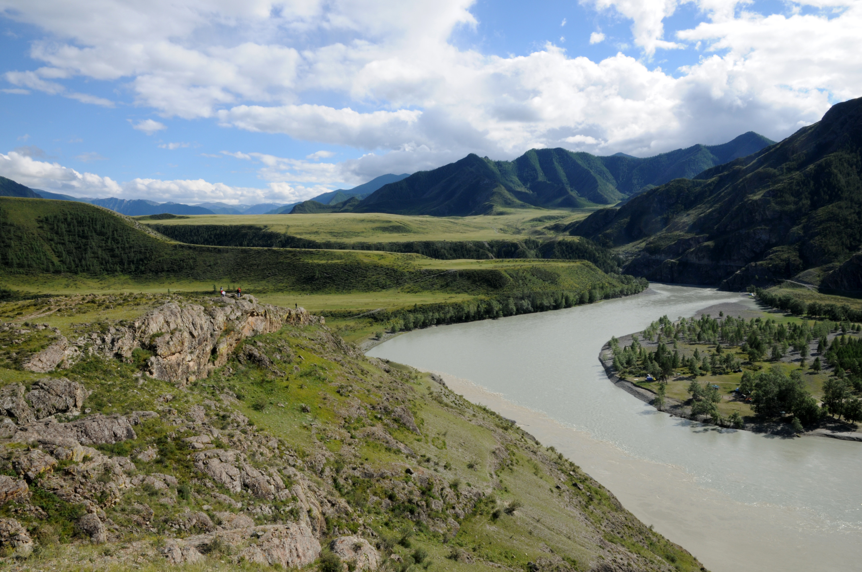

Transboundary Conservation Areas
Introduction: Overview and Objectives of the Training Module
Notes:
Photo Credit: Altai-Sayan ©IUCN / Boris Erg
*Note that all of the photos in this presentation are of Altai-Sayan transboundary region shared by China, Kazakhstan, Mongolia and Russia.
This presentation can be used to introduce the training module and the specific workshop.
It covers the introductory material presented in the Overview section of the Trainer’s Manual.
The module should be modified to include specific information about each training, including an introduction of the trainers and the agenda.

Slide 2

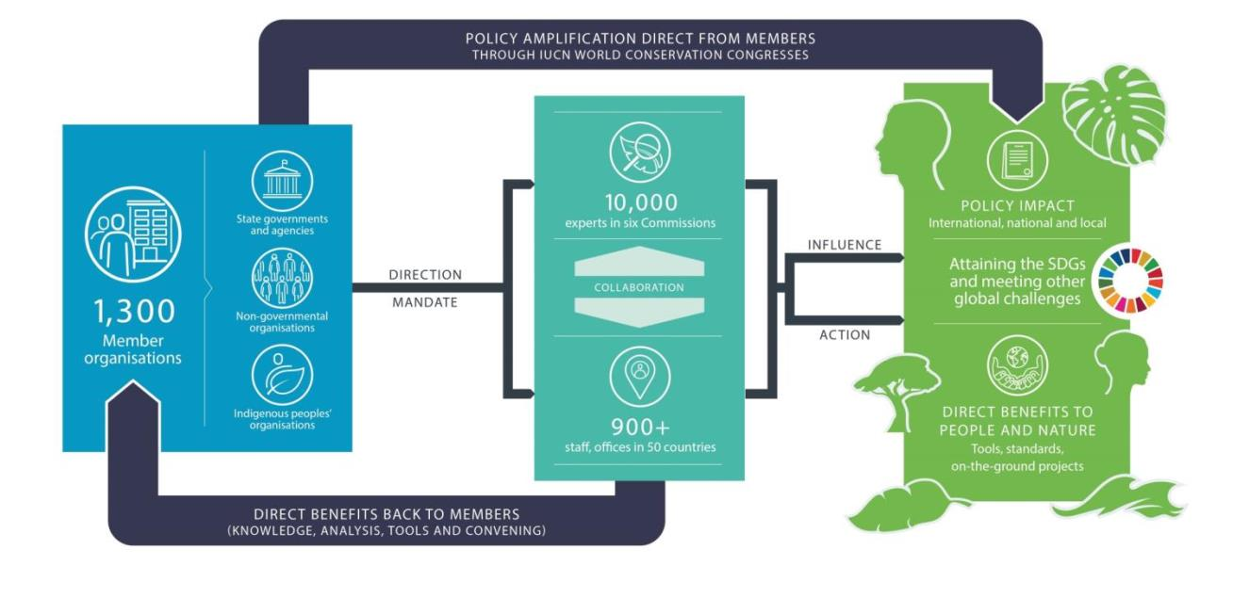
IUCN: United for Life and Livelihood
www.iucn.org
Notes:
Introduction
This slide introduces IUCN, the developer of this module.
Insert additional slides to introduce other organizations affiliated with the training, as appropriate.

Slide 3
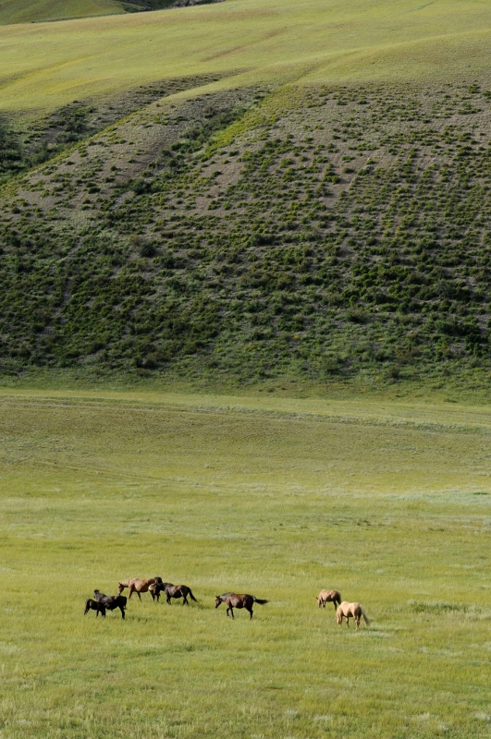
Project
Project: Development and Piloting a Training Module on Initiating Transboundary Conservation
Objective: Develop a three-day, globally applicable training module on initiating transboundary conservation based on the IUCN Best Practice Protected Area Guidelines ”Transboundary Conservation: A systematic and integrated approach” (2015)
Implementation: IUCN ECARO, IUCN ELC, IUCN WCPA Transboundary Conservation SG
Duration: February 2018 – January 2019
Donor: German Federal Agency for Nature Conservation (Bundesamt für Naturschutz, BfN)
Notes:
Photo Credit: Altai-Sayan ©IUCN / Boris Erg
Project
This slide introduces the project that led to the development of this module.
You can edit this slide or add a new one to describe additional projects or partners involved in the training.

Slide 4

The Federal Agency for Nature Conservation (BfN)
BfN is the German government’s scientific authority with responsibility for national and international nature conservation. BfN is one of the government’s departmental research agencies and reports to the German Environment Ministry.
The Agency provides the German Environment Ministry with professional and scientific assistance in all nature conservation and landscape management issues and in international cooperation activities. BfN furthers its objectives by carrying out related scientific research and is also in charge of a number of funding programmes.
With its International Academy for Nature Conservation on the Isle of Vilm, BfN has initiated this project in frame of its international capacity building activities.

Slide 5
Objective and Aim
Initiating Transboundary Conservation
Strengthen capacity to assess the feasibility of establishing a Transboundary Conservation Area
Enable practitioners to develop strategies to address critical issues and success factors
Notes:
Photo Credit: Altai-Sayan ©IUCN / Boris Erg
Objectives
This slide introduces the overall objectives of the training module. If a specific training has additional objectives, they can be added here.

Slide 6
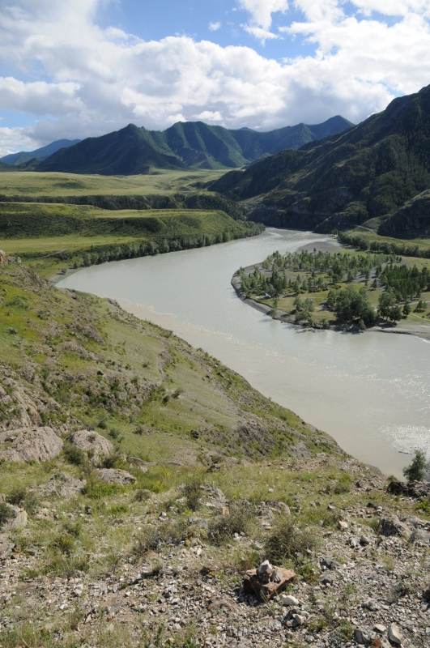
Factors of Success
Assess the enabling environment to pursue transboundary conservation
Define the transboundary context and relationships affecting the achievement of the conservation targets and the resulting geographic extent
Identify and involve stakeholders, obtain support of decision makers and ensure political will and buy-in
Agree on common values and joint vision
Determine common transboundary management objectives and develop cooperative agreements
Notes:
Photo Credit: Altai-Sayan ©IUCN / Boris Erg
Factors of success
The training module is organized around 5 key factors of success in the process of initiating transboundary conservation:
1. Assess the enabling environment to pursue transboundary conservation
2. Define the transboundary context and relationships affecting the achievement of the conservation targets and the resulting geographic extent
3. Identify and involve stakeholders, obtain support of decision makers and ensure political will and buy-in
4. Agree on common values and joint vision
5. Determine common transboundary management objectives and develop cooperative agreements

Slide 7
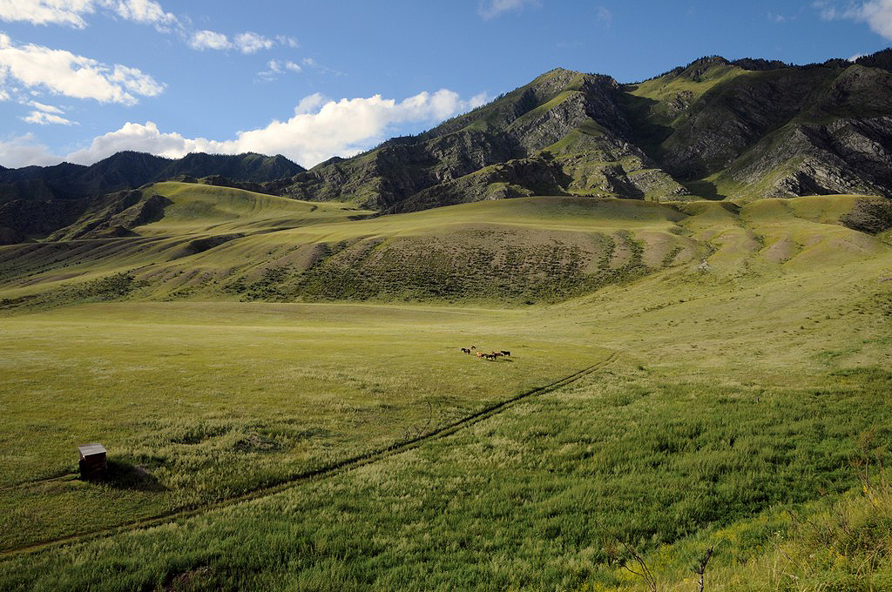
Nature of the Module
Globally applicable and generic
Adaptable for different regions and environments
National, regional and local level
Designed for face-to-face instruction
Accessible and open
Notes:
Photo Credit: Altai-Sayan ©IUCN / Boris Erg
Nature of the module
The training module is:
A generic, globally applicable training module on initial phases of transboundary conservation
Adaptable for different regions, and suitable to be taught by diverse actors in nature conservation
Intended to enable practitioners on national, regional and local level to effectively plan, initiate and institutionalize transboundary conservation
Designed to be used for face-to-face instruction
Open knowledge source accessible for all interested training providers with a view to creating a multiplier effect.

Slide 8
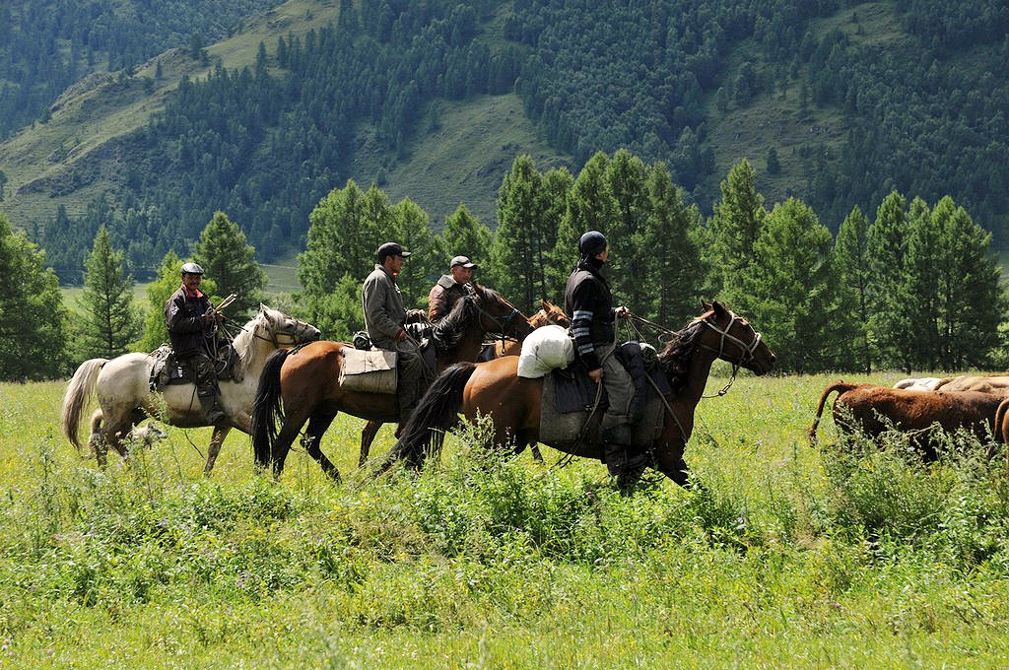
Audience
This module targets individuals and institutions engaged in supporting, planning and designing the transboundary conservation process
Policymakers
Civil society organizations
Government officials
Community representatives
Protected area staff
Scientists and conservationists
Border police
Tourist marketing organizations
Notes:
Photo Credit: Altai-Sayan ©IUCN / Boris Erg
Audience
This module targets individuals and institutions engaged in supporting, planning and designing the transboundary conservation process, such as:
Policymakers
Government officials
Protected area staff: a) executive, b) senior manager, c) middle manager / technical specialist, d) skilled worker (cp. IUCN (2016): Global Register for Comptencies in Protected Area Practitioners)
Border police
Civil society organizations
Community leaders
Scientists and conservationists
Tourist marketing organizations
The training will cover the training needs of these audiences which are specific to the transboundary context. Trainers can choose from the training module those parts which fit their specific audience. When addressing different target groups, their varied level of prior knowledge and skills needs to be taken into account. The original training module has to be tailored for the specific needs of each target audience. The audience should be fluent in English and needs knowledge of basic nature conservation concepts and approaches.

Slide 9
Didactical Approach
Knowledge transfer
Skills development
Experience sharing
Notes:
Photo Credit: Altai-Sayan ©IUCN / Boris Erg
Didactical approach
The training course will build capacity through three interconnected teaching mechanisms:
Knowledge transfer: presentations and seminar-style discussion
Skills development: exercises based around one or more fictional case study
Experience sharing: formal and informal sharing of perspectives and experiences.

Slide 10
Lessons
Lesson 1
Introduction and background to Transboundary Conservation Areas
Lesson 2
Typology of Transboundary Conservation Areas
Lesson 3
Initiating transboundary conservation: Diagnose the situation
Lesson 4
Transboundary conservation governance
Lesson 5
Initiating transboundary conservation: Design the process I
Lesson 6
Cooperative management in transboundary conservation
Lesson 7
Initiating transboundary conservation: Design the process II
Lesson 8
Final thoughts
Notes:
Photo Credit: Altai-Sayan ©IUCN / Boris Erg
Lessons
Provide an overview of the lessons covered in this module.
Introduction and background to Transboundary Conservation Areas
Typology of Transboundary Conservation Areas
Initiating transboundary conservation: Diagnose the situation
Transboundary conservation governance
Initiating transboundary conservation: Design the process I - Engage the right people and define the geographic extent
Cooperative management in transboundary conservation
Initiating transboundary conservation: Design the process II: Negotiate a joint vision and develop management objectives
Final thoughts

Slide 11
Team
Maja Vasilijević, Vice-Chair, IUCN WCPA Transboundary Conservation Specialist Group
Lydia Slobodian, Senior Legal Officer, IUCN Environmental Law Centre
Boris Erg, Director, IUCN Regional Office for Eastern Europe and Central Asia
Steering Group Members:
Clara Bocchino, Network Coordinator and Facilitator, SADC TFCA
Goran Gugić, Senior Adviser NATURA2000 and Protected Areas, GIZ/CIM-IF
Alois Lang, Public Relations and Ecotourism Expert, Neusiedler See-Seewinkel National Park
Bert Lenten, Former Deputy Executive Secretary of the Convention on the Conservation of Migratory Species of Wild Animals (CMS) and former Executive Secretary AEWA, Lenten Conservation Consultancy
Andrea Strauss, Deputy Head of Unit "International Academy for Nature Conservation", German Federal Agency for Nature Conservation
Notes:
Photo Credit: Altai-Sayan ©IUCN / Boris Erg
Team
This slide shows the team involved in developing the module.
Edit this slide or add additional slides to introduce the trainers involved in the specific training. It can be a good idea to ask each trainer to prepare their own slide, with a photograph and short description of their experience and background.

Slide 12
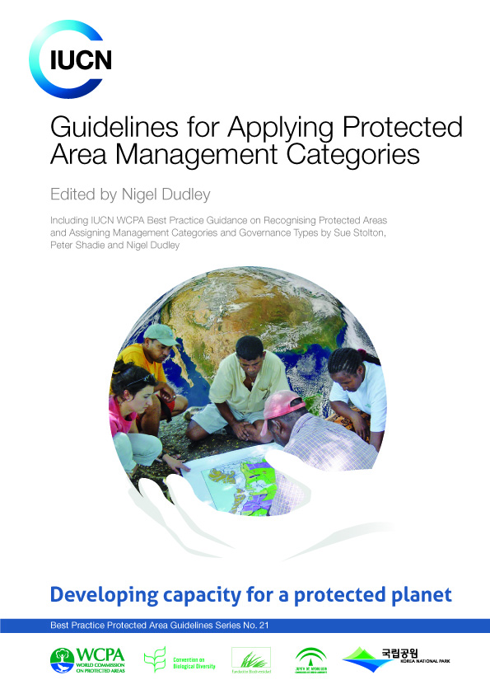
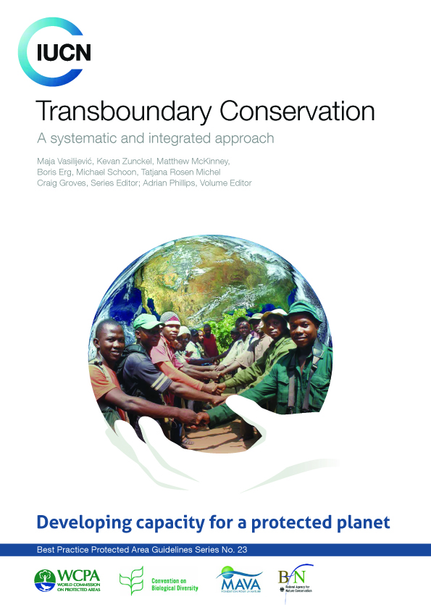
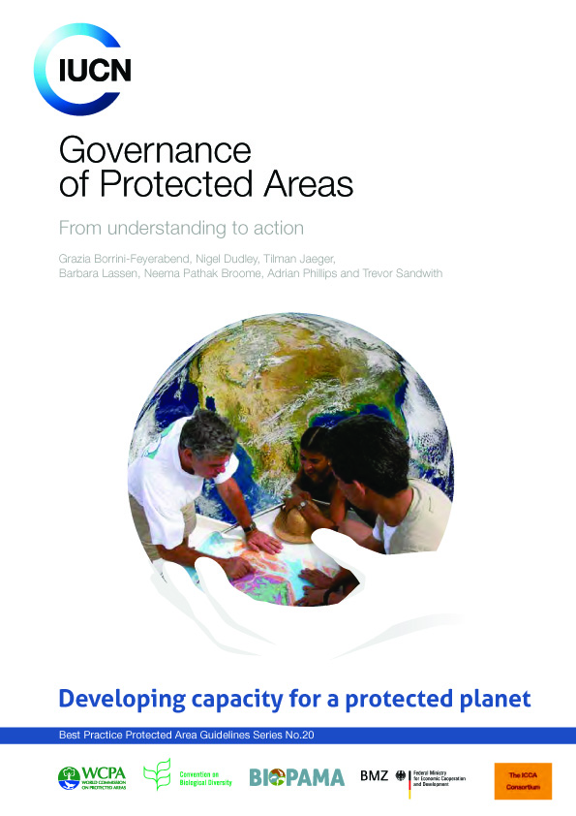
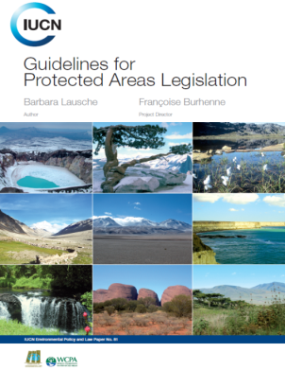
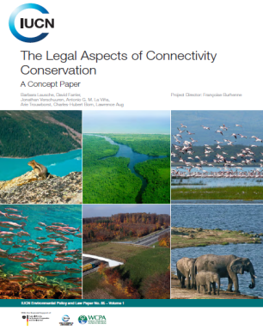
Knowledge Base
Notes:
Knowledge base
The module draws primarily on:
Vasilijević, M., Zunckel, K., McKinney, M., Erg, B., Schoon, M., Rosen Michel, T. (2015). Transboundary Conservation: A systematic and integrated approach. Best Practice Protected Area Guidelines Series No. 23, Gland, Switzerland: IUCN.
https://portals.iucn.org/library/sites/library/files/documents/PAG-023.pdf
Additional important resources include:
Erg, B., Vasilijević, M. and McKinney, M. (eds.). (2012). Initiating Effective Transboundary Conservation: A Practitioner’s Guideline Based on the Experience from the Dinaric Arc. Gland, Switzerland and Belgrade, Serbia: IUCN Programme Office for South-Eastern Europe.
https://cmsdata.iucn.org/downloads/initiating_effective_transboundary_conservation.pdf
Vasilijević, M. (2012). Diagnostic Tool for Transboundary Conservation Planners: Suggested Questions to Determine Feasibility for Transboundary Conservation. In: Erg, B., Vasilijević, M. and McKinney, M. (eds.). Initiating Effective Transboundary Conservation: A Practitioner’s Guideline Based on the Experience from the Dinaric Arc. Gland, Switzerland and Belgrade, Serbia: IUCN Programme Office for South-Eastern Europe. http://www.tbpa.net/page.php?ndx=22
Lausche, B. (2011). Guidelines for Protected Areas Legislation. IUCN, Gland, Switzerland.
https://www.iucn.org/content/guidelines-protected-areas-legislation-0
Lausche, B., Farrier, D., Verschuuren, J., La Viña, A. G. M., Trouwborst, A., Born, C-H., Aug, L. (2013). The Legal Aspects of Connectivity Conservation. A Concept Paper, IUCN, Gland, Switzerland.
https://www.iucn.org/sites/dev/files/legal_aspects_of_connectivity_conservation-_a_concept_pape.pdf
Dudley, N. (ed.). (2008). Guidelines for Applying Protected Area Management Categories. Gland, Switzerland: IUCN. WITH Stolton, S., Shadie, P. and Dudley, N. (2013). IUCN WCPA Best Practice Guidance on Recognising Protected Areas and Assigning Management Categories and Governance Types. Best Practice Protected Area Guidelines Series No. 21. Gland, Switzerland: IUCN.
https://www.iucn.org/sites/dev/files/import/downloads/iucn_assignment_1.pdf
Borrini-Feyerabend, G., Dudley, N., Jaeger, T, Lassen, B., Pathak Broome, N., Phillips, A. and Sandwith, T. (2013). Governance of Protected Areas: From Understanding to Action. Best Practice Protected Area Guidelines Series No. 20. Gland, Switzerland: IUCN.
https://portals.iucn.org/library/sites/library/files/documents/PAG-020.pdf

Slide 13
“The national divisions of today may coincide to some greater or lesser extent with ethnic, religious, linguistic, or ideological groupings. What they do not very often coincide with is units determined by ecological factors, that is, ecosystems or ecogeographical regions” (Westing, 1993)
“Start anywhere: just get started”
(Ramsar Convention on Wetlands: Resolution IX.1 Annex C I, Chapter IV)
www.iucn.org
www.tbpa.net
Notes:
Photo Credit: Altai-Sayan ©IUCN / Boris Erg
The recommendation to “Start anywhere: just get started” highlights the need for long-term commitment and perseverance in transboundary conservation processes. This approach includes the need to first think about the compelling reason for transboundary action profoundly and then start with small, well-sequenced steps.
For more informaition, please visit:
www.iucn.org
www.tbpa.net

Slide 14
Transboundary Conservation Areas
End of Introduction
Notes:
Photo Credit: Altai-Sayan ©IUCN / Boris Erg
This Presentation is a Template
You can use this as a basis to introduce the module and your workshop.

